Slide 1
Welcome Parents!
Curriculum night 2015
Life Science
Ms. Pouncey’s class

Slide 2
Email/ Communication
Email- pouncey@fultonschools.org
Website- kristinnolan.weebly.com
**Both can be found on CMS website**

Slide 3
Meet the Teacher
- Born on February 19th.
- From Cumming, GA, but currently living in Dunwoody.
- Went to college at Reinhardt University
- 4th year teaching, but 1st year at Crabapple.
- Favorite Hobbies: running, reading, and being outdoors.

Slide 4
Schedule
- 8:55 to 9:20 Homeroom
- 9:24 to 11:01 Connections
- 11:05 to 11:55 4th Period
- 11:58 to 12:48 5th Period
- 12:51 to 1:21 Lunch
- 1:27 to 2:17 6th Period
- 2:20 to 3:10 7th Period
- 3:13 to 4:03 8th Period

Slide 5
Life Science
Students will gain a deeper understanding of Life Science Concepts including:
S7L1. Students will investigate the diversity of living organisms and how they can be compared scientifically.
S7L2. Students will describe the structure and function of cells, tissues, organs, and organ systems.
S7L3. Students will recognize how biological traits are passed on to successive generations.
S7L4. Students will examine the dependence of organisms on one another and their environments.
S7L5. Students will examine the evolution of living organisms through inherited characteristics that promote survival of organisms and the survival of successive generations of their offspring.

Slide 6
Yearly Curriculum Map
Classifications 3 Weeks | Cells 5 Weeks | Genetics 6 Weeks | Human Body 3 Weeks | Evolution 4 Weeks | Ecology 4 Weeks
S7L1- Students will investigate the diversity of living organisms and how they can be compared scientifically. Demonstrate the process for development of a dichotomous key. Classify organisms based on physical characteristics using a dichotomous key of the six kingdom system. ( archaebacteria, eubacteria, protists, fungi, plants, and animals) | S7L2- Students will describe the structure and function of cells, tissues, organs, and organ systems. Explain that cells take in nutrients in order to grow and divide and to make needed materials. Relate cell structures (cell membrane, nucleus, cytoplasm, chloroplasts, mitochondria) to basic cell function. | S7L3- Students will recognize how biological traits are passed on to successive generations. Explain the role of genes and chromosomes in the process of inheriting a specific trait. Compare and contrast that organisms reproduce asexually ad sexually (bacteria, protists, fungi, plants and animals). Recognize that selective breeding can produce plants and animals with desired traits. | S7L2- Students will describe the structure and function of cells, tissues, organs, and organ systems. Explain that cells are organized into tissues, tissue into organs, organs into systems, and systems into organisms. Explain that tissues, organs, and organ systems serve the need cells have for oxygen, food, and waste removal. Explain the purpose of the major organ systems in the human body (digestion, respiration, reproduction, circulation, excretion, movement, control, and coordination, and for protection from disease) | S7L5- Students will examine the evolution of living organisms through inherited characteristic that promote survival of organisms and the survival of successive generations of their offspring. Explain that physical characteristics of organisms have changed over successive generations (e.g. Darwin’s finches and peppered moths of Manchester) Describe ways in which species on Earth have evolved due to natural selection. Trace evidence that the fossil record found in sedimentary rock provides evidence for the long history of changing life forms. | S7L4- Students will examine the dependence of organisms on one another and their environments. Demonstrate in a food web that matter is transferred from one organisms to another and can recycle between organisms and their environments. Explain in a food web that sunlight is the source of energy and that this energy moves from organism to organism. Recognize that changes in environment

Slide 7
Procedures
Students walk in, look at board, begin warm up or update agenda with homework and update table of contents
Warm up is discussed
Homework and announcements discussed
Classwork for the day: notes, labs, activities
Closing: Review of key points from the day, review of homework and announcements, preview of the next day.

Slide 8
Make-up
- If student misses an assignment or needs to retake, please have them come to the next available help session.
- Help Sessions are on Mondays at 8:00, but is they need to make up something they can be here any day at 8:00 to do so

Slide 9
Grading
Summative- 20% of grade
Classwork
Homework
Quizzes
Formative- 80% of grade
Tests
Projects
Labs
**Most units will have one project and one unit test**

Slide 10
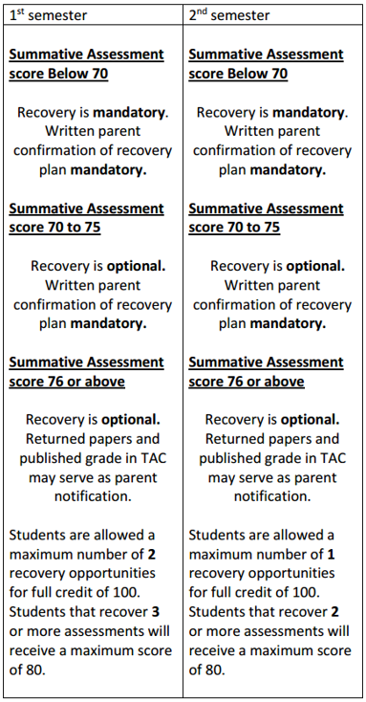
Recovery Policy for 7th Grade

Slide 11
Classroom Wish List
Tissues
Clorox/ Lysol Wipes
Paper
Pencils
Pens

